Slide 1
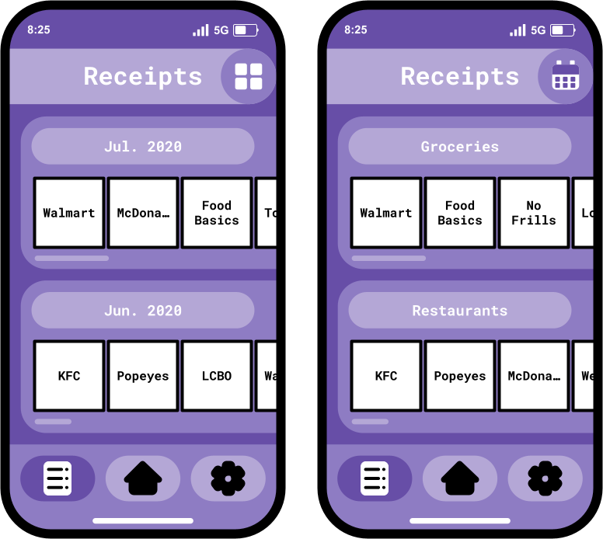
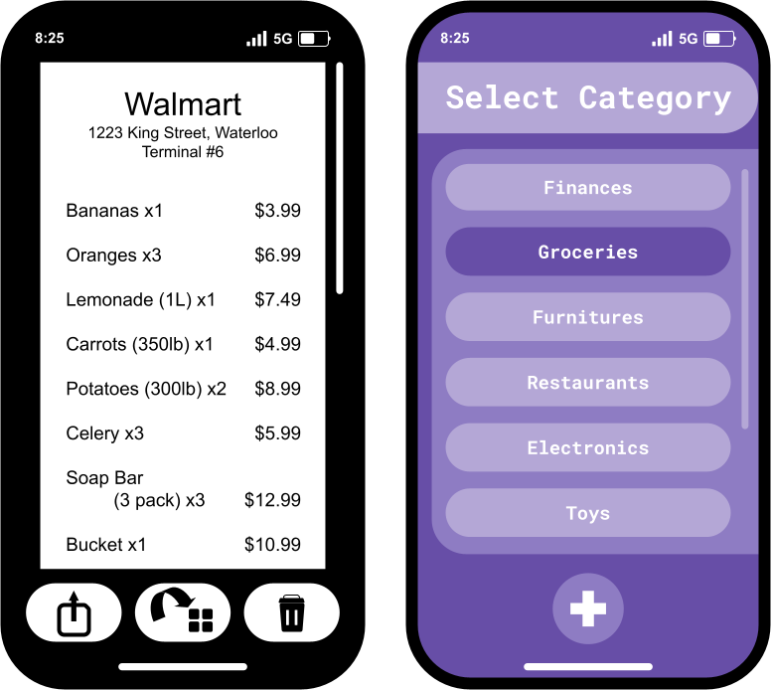
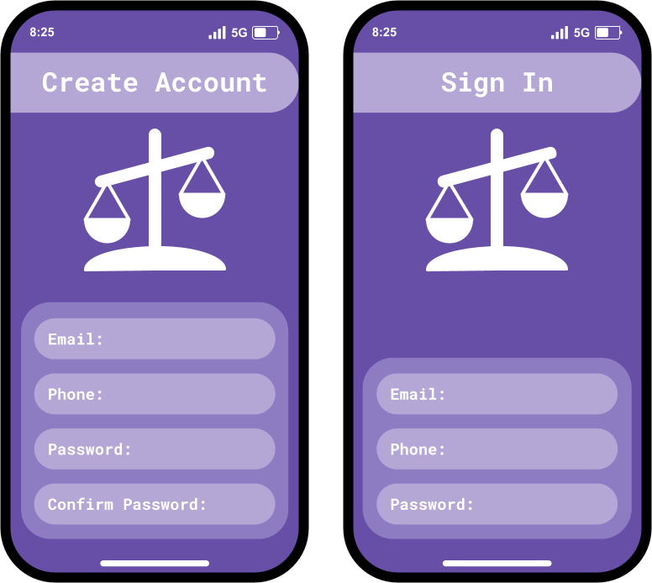
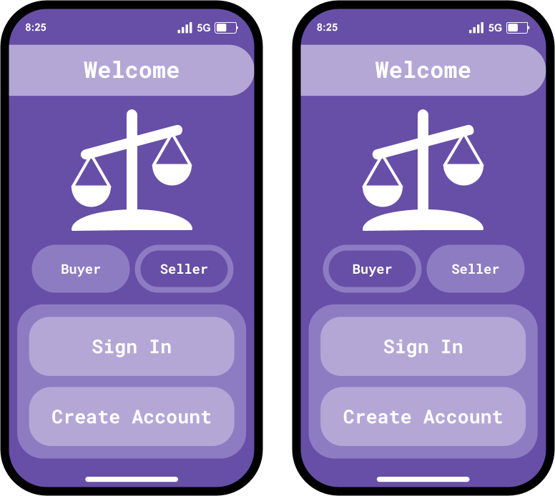
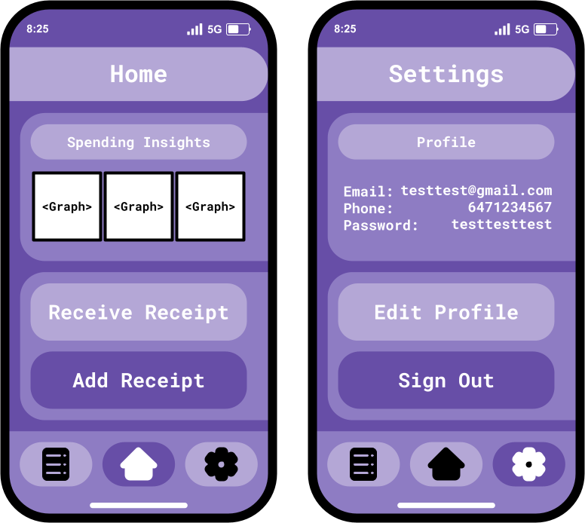
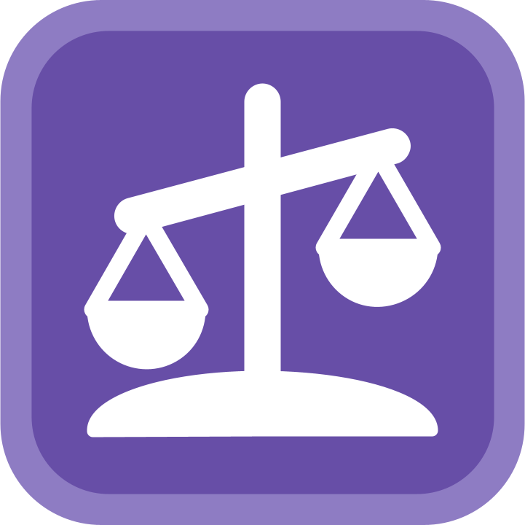
Balance
Notes:
Luke Aikman

Slide 2
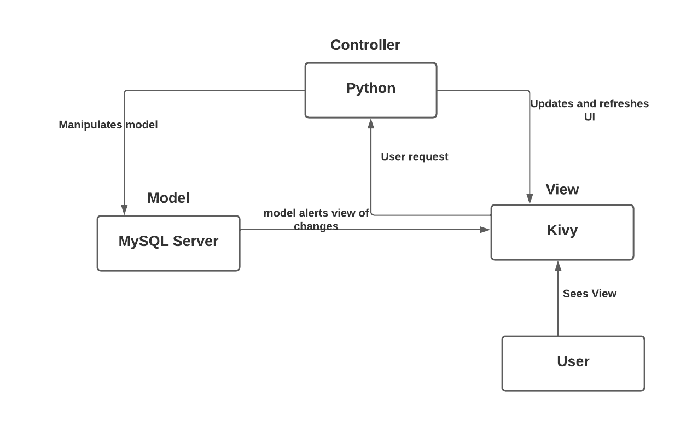
Architectural Diagrams
Notes:
Branden Wheeler
· Model View Controller architecture
o Commonly used for mobile
o Frequent changes to data model requires a pattern that quickly reflects the model
· Model
o MySQL Server Database
o Allows for persistent storage between application running instances
o Processed data for use by the view and the controller
· Controller
o Built using Python
o Creates and manages objects and their interactions
o Added level of abstraction to database operations
o Updated user view based on certain conditions
· View
o Kivy used to build native applications for all devices
o Needed something simple that would work for everyone
· Team
o MVC allows for division of work which is what we did
o Reduce interdependencies since each part was built and tested separately
· Conclusion
o This was the best choice for our application
o Transition to class diagrams

Slide 3
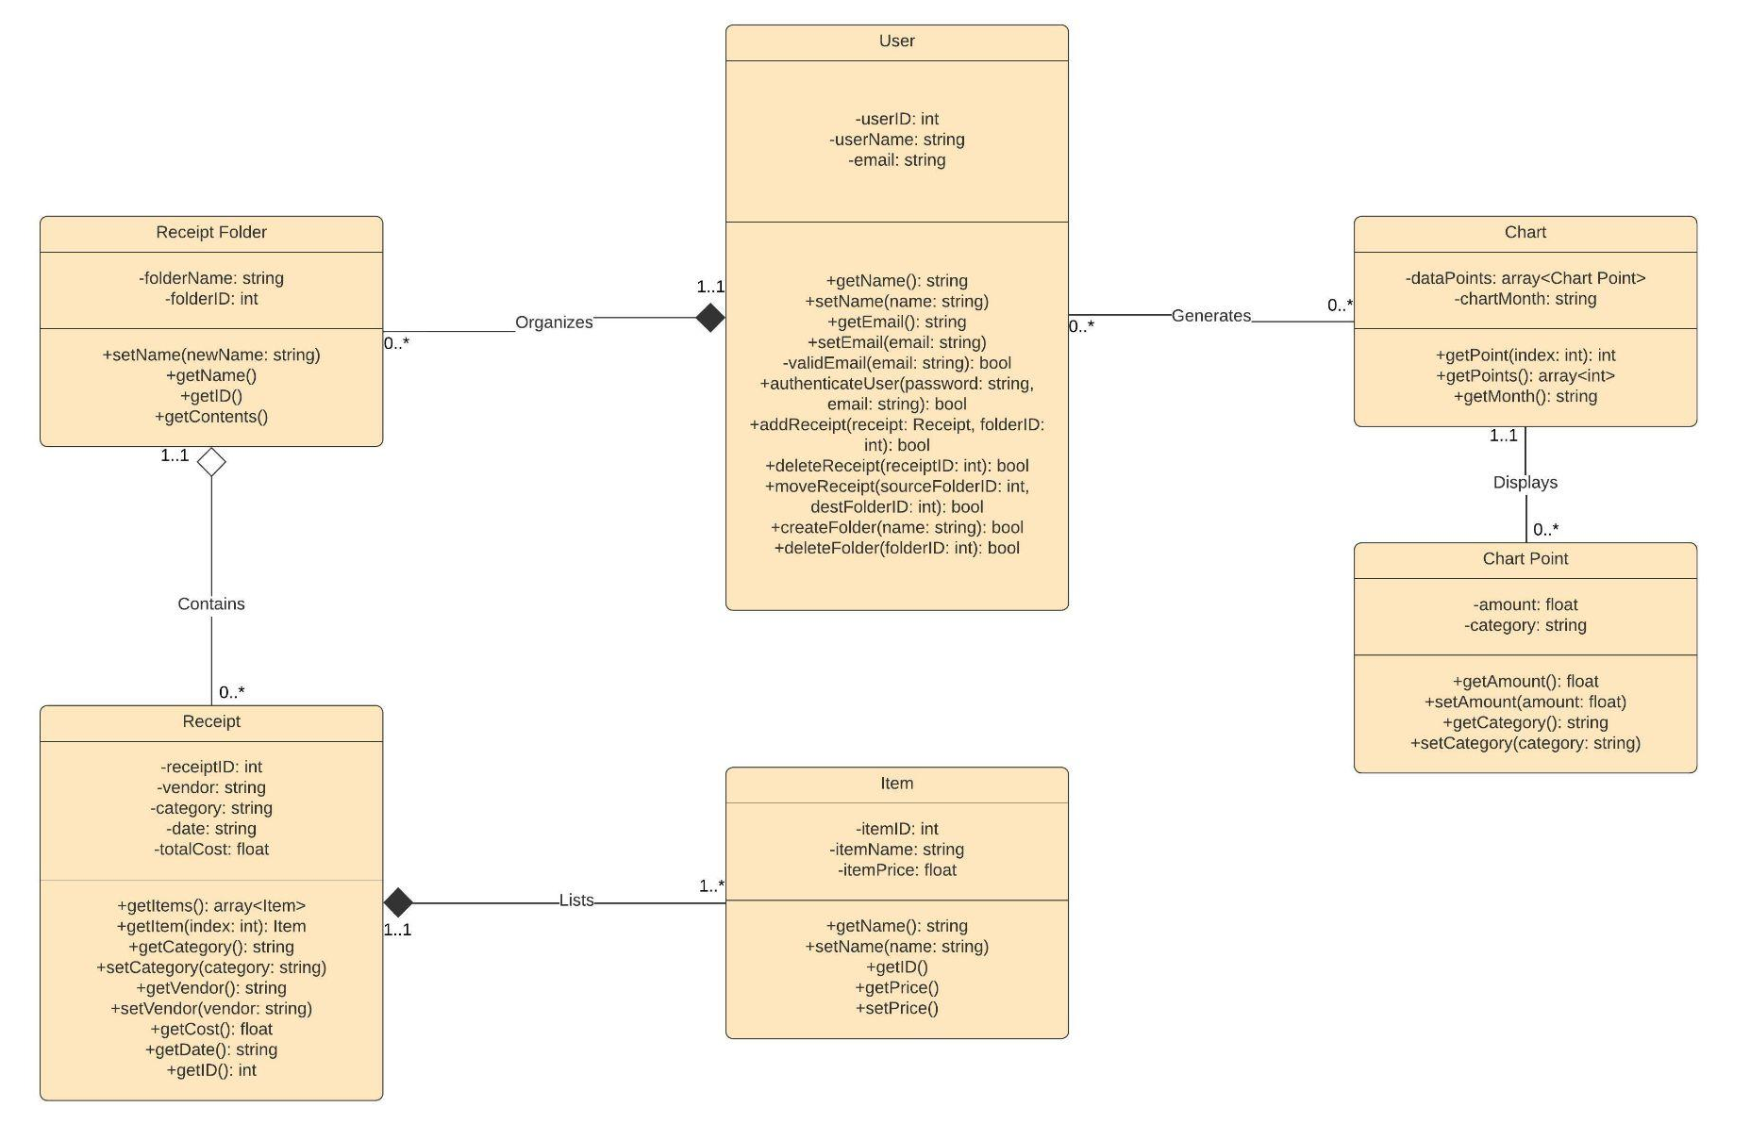
Class Diagrams
Notes:
Ninam Rai
Aggregation has a hollow (white) diamond.
Composition has a filled (black) diamond.
x and y coordinates or in our case the total and the category for the month

Slide 4
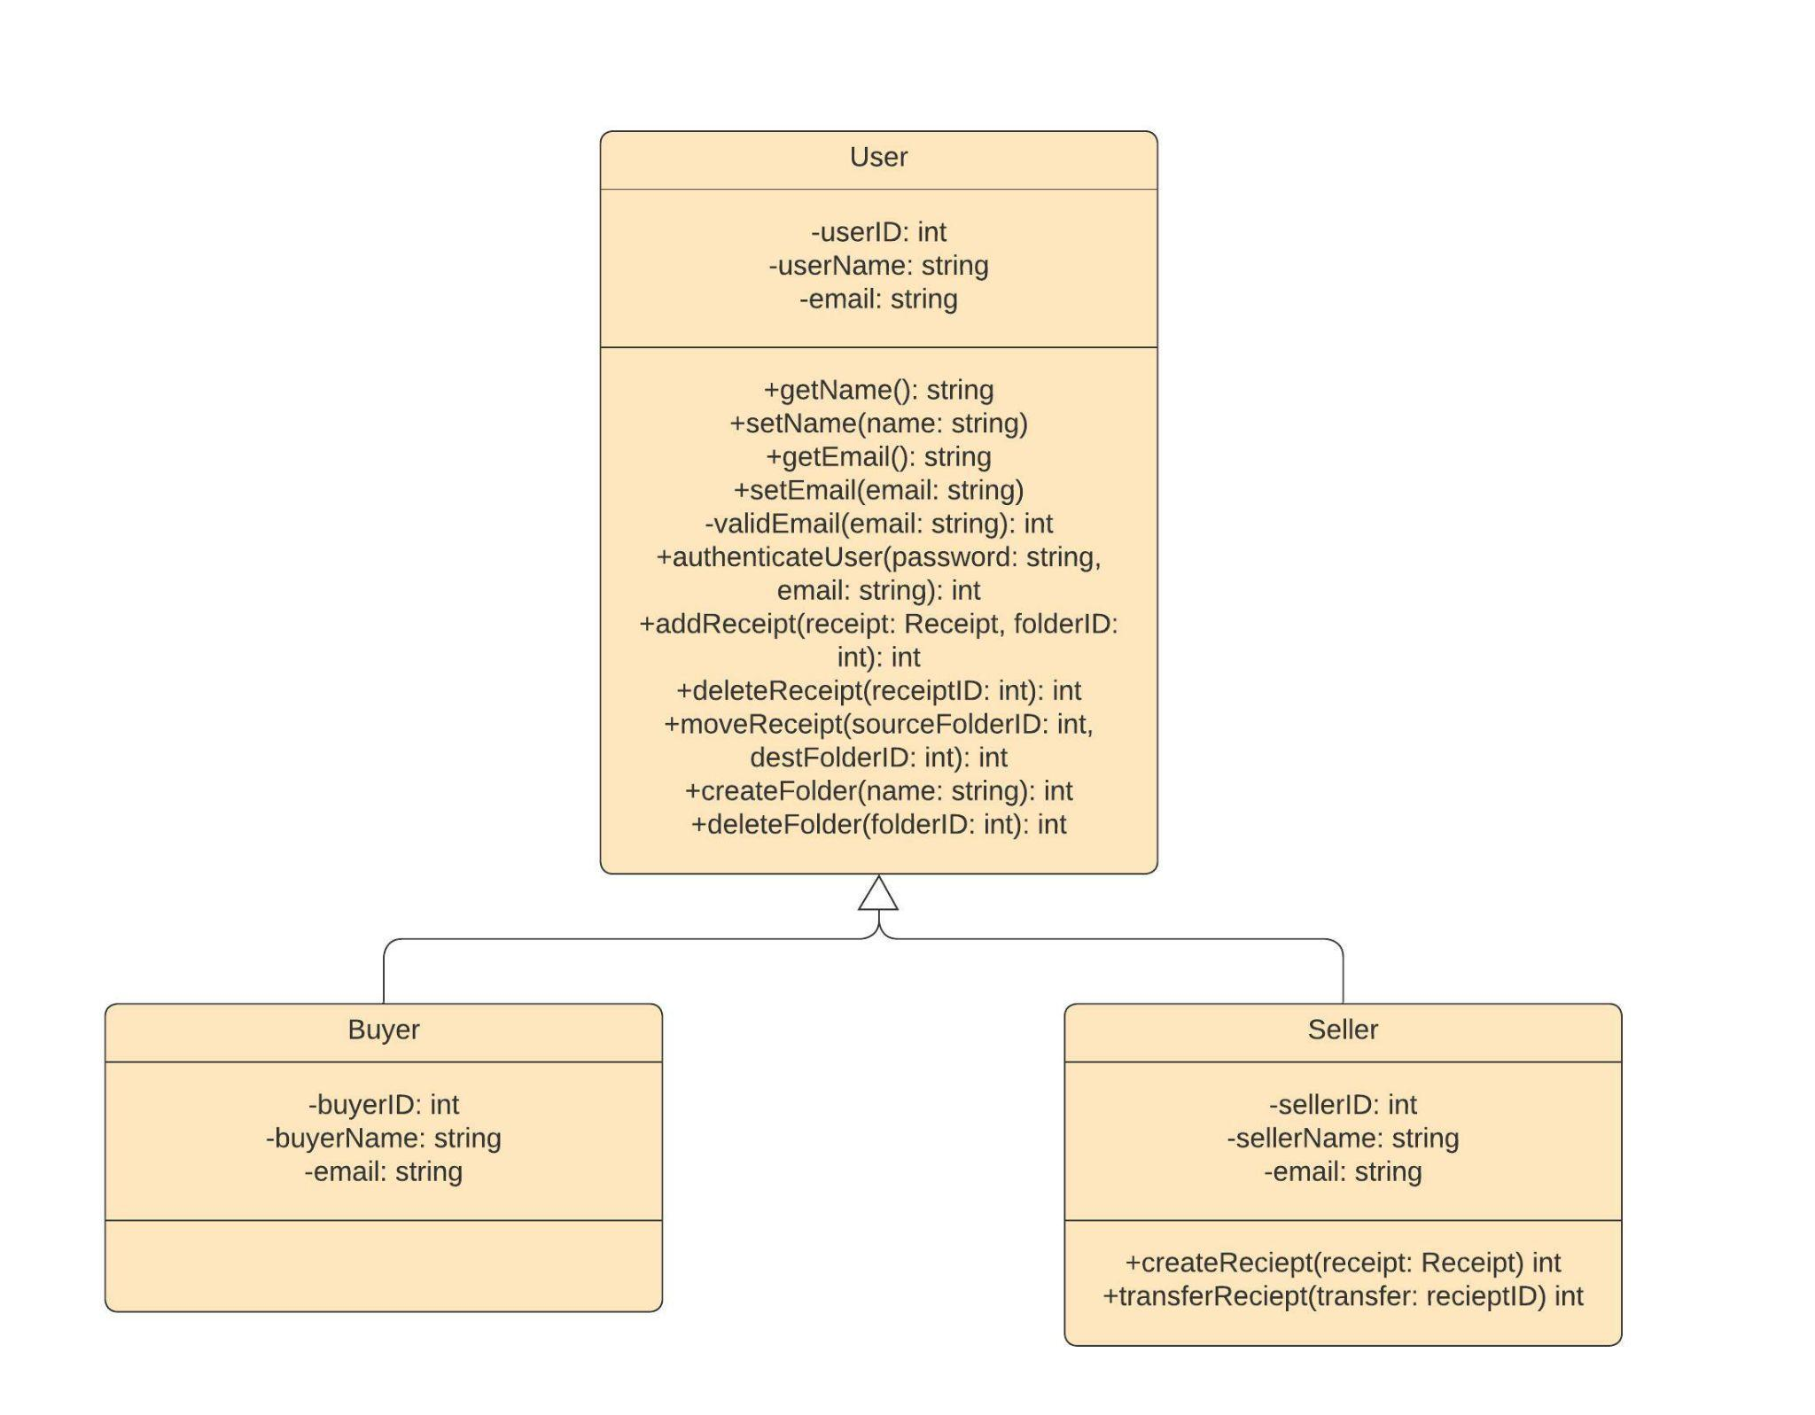
User
Class
Diagrams
Notes:
Ninam Rai

Slide 5
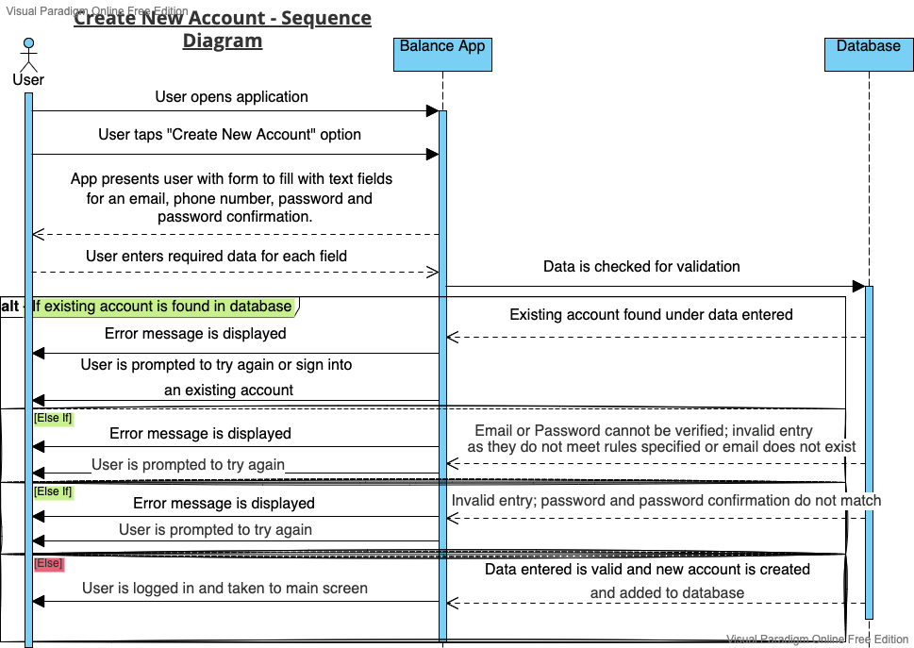
Sequence Diagrams
Notes:
Haniah Khan

Slide 6
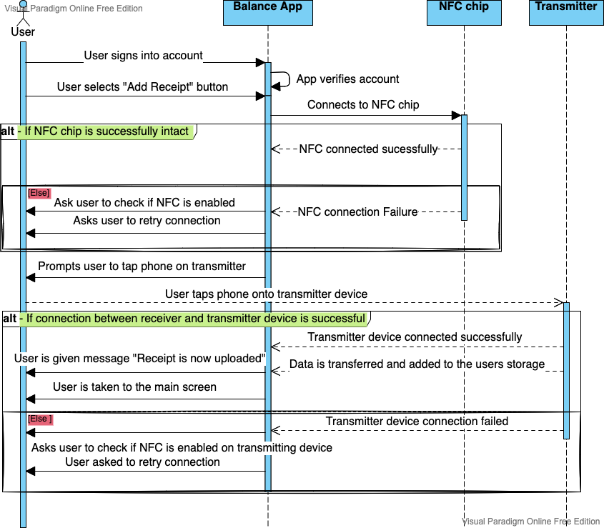
Sequence Diagrams - Tap to Upload Diagram
Notes:
Haniah Khan

Slide 7
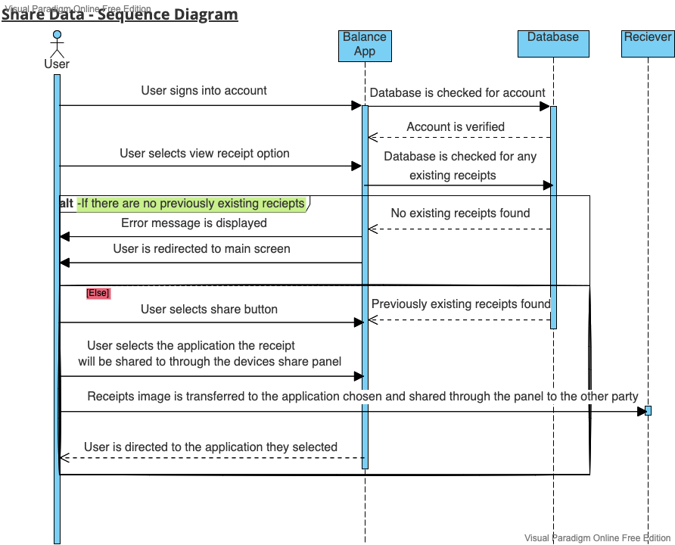
Sequence Diagrams
Notes:
Haniah Khan

Slide 8
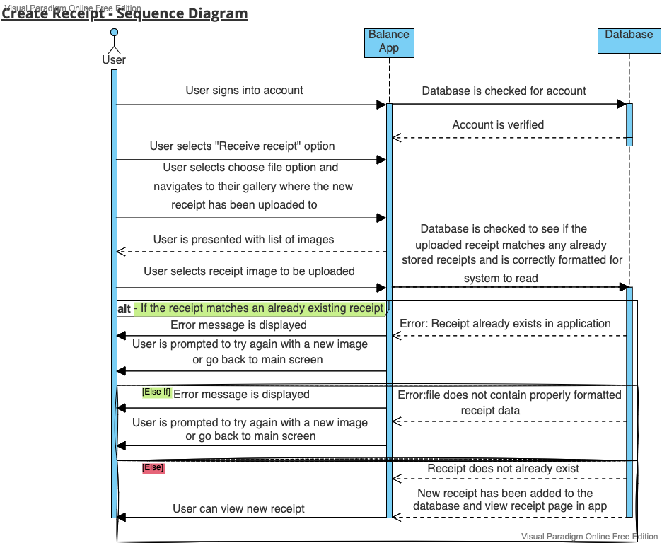
Sequence Diagrams
Notes:
Haniah Khan

Slide 9
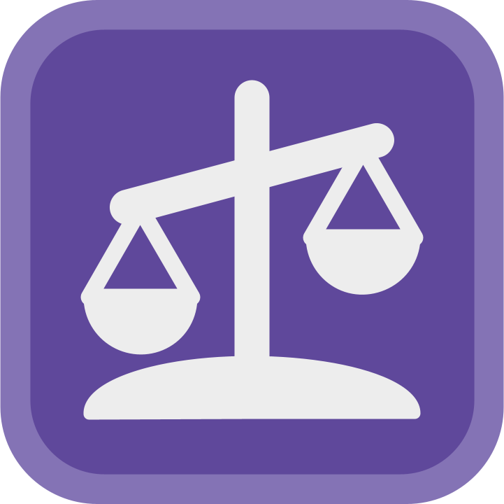
Conclusion
Notes:
Luke Aikman

